Slide 1

Turkey House Sales to Foreigners
Data Analysis
Road Runner
December 2019

Slide 2
What we have as source data?
House Sales Foreigners
Year,Province, sales counts per month
House Sales by Nationalities
Year,Country,
counts per Months
House Sales Gender
Year,City,Female,Male,
Common,Other,Total
House sales Provinced based
Year;Month;Province;Mortgaged_FirstHand_Sale;
Mortgaged_SecondHand_Sale;Other_FirstHand_Sale;
Other_SecondHand_Sale

Slide 3


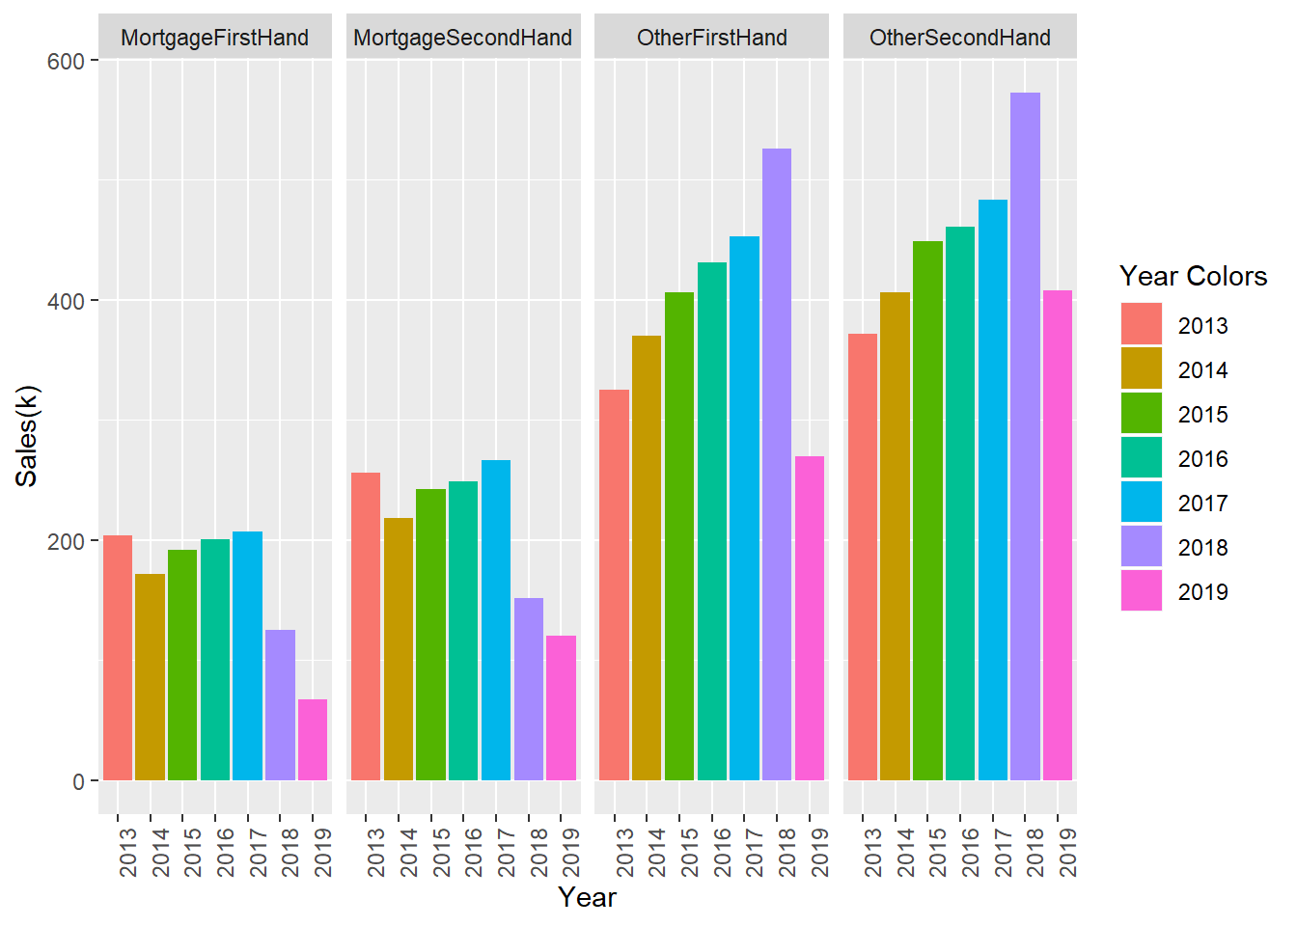
5932005
5932005
Total Sales Numbers through Years by Sales Type between years 2013-2019
The sales payment type distribution
M
O
2.671.524
Morgaged sales
summary
5.932.005
Other payment Sales
Summary
We can observe that no mortgage is
needed for most of the foreigners.

Slide 4
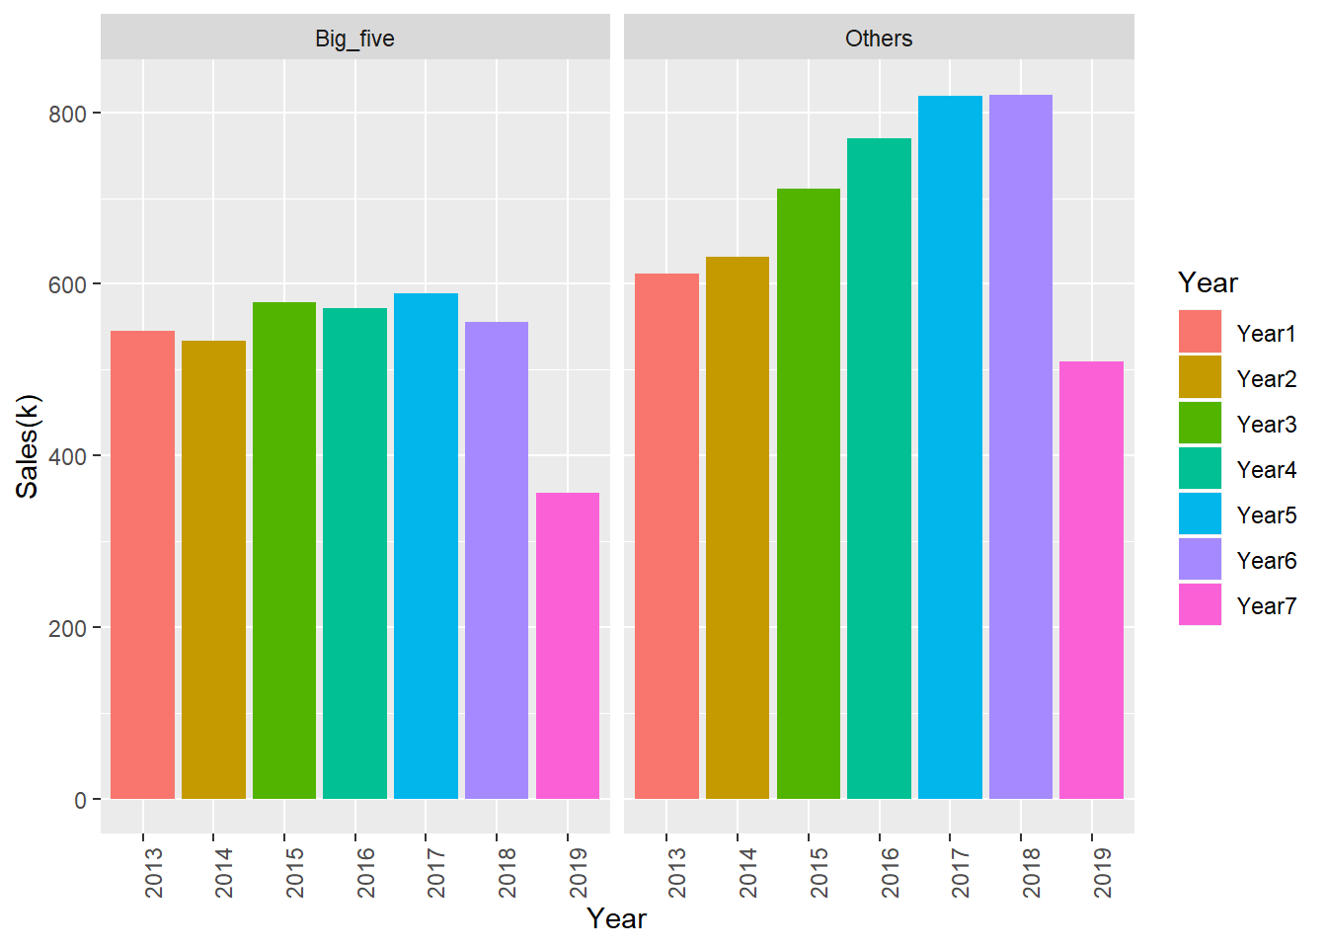
Total Sales Numbers Comparising Five most populated Cities and the Others
M
M
O
O
1281777
Morgaged sales
Big Cities
1281777
Morgaged sales
Big Cities
2448061
Other Sales
Big Cities
3483944
Other
Sales
Big Cities

Slide 5

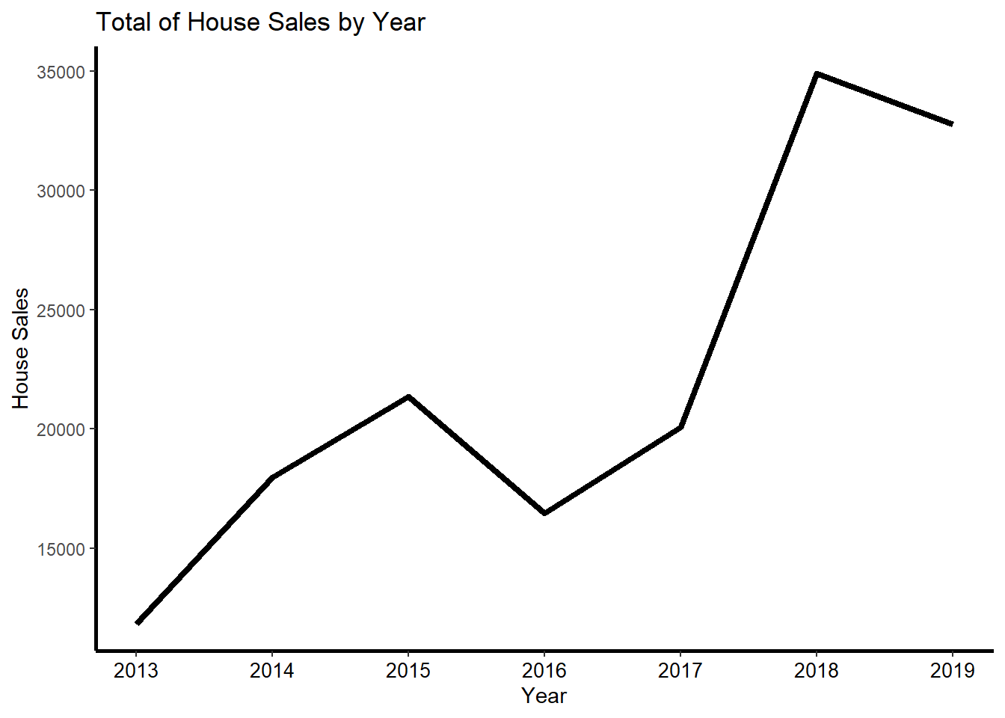
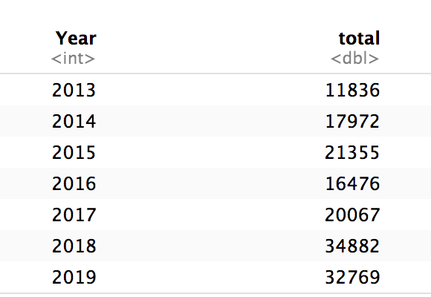
House Sales by Year
House sales to foreigners between 2017 and 2018 is
remarkable increased. Since 2019 November and December
sales could not be reflected into this analysis,
the change between 2018 and 2019 could not be determined.

Slide 6
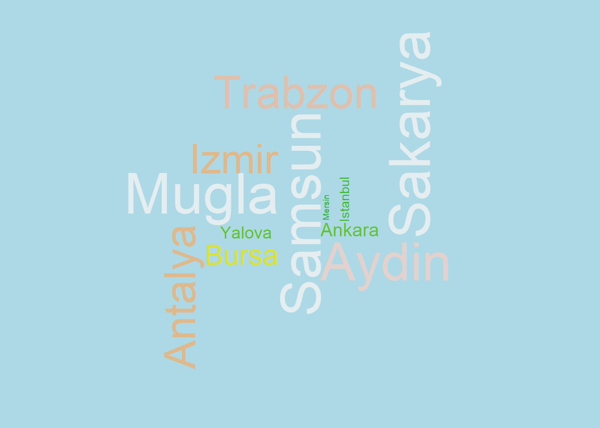
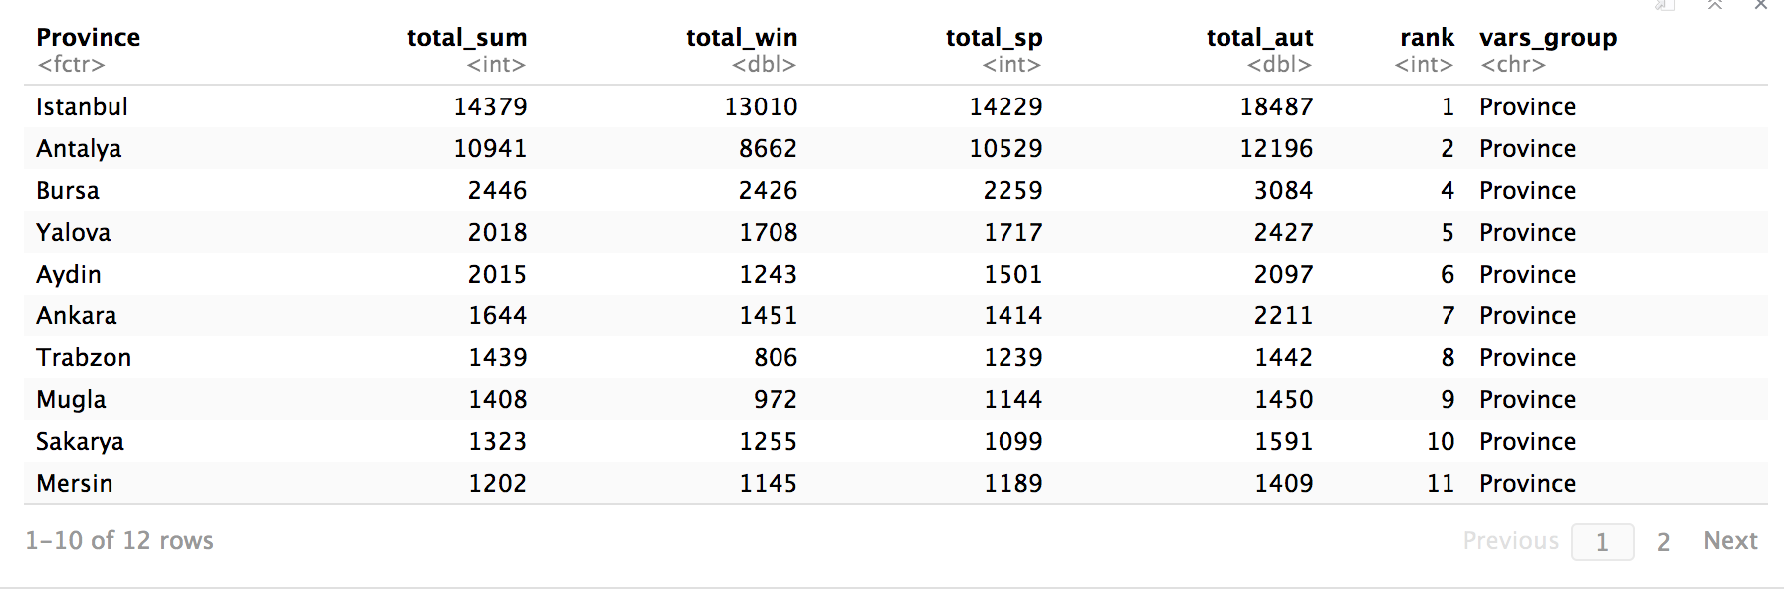
Sales numbers to foreigners are
shared in several of cities.
We examine the sales up to seasons as well.

Slide 7
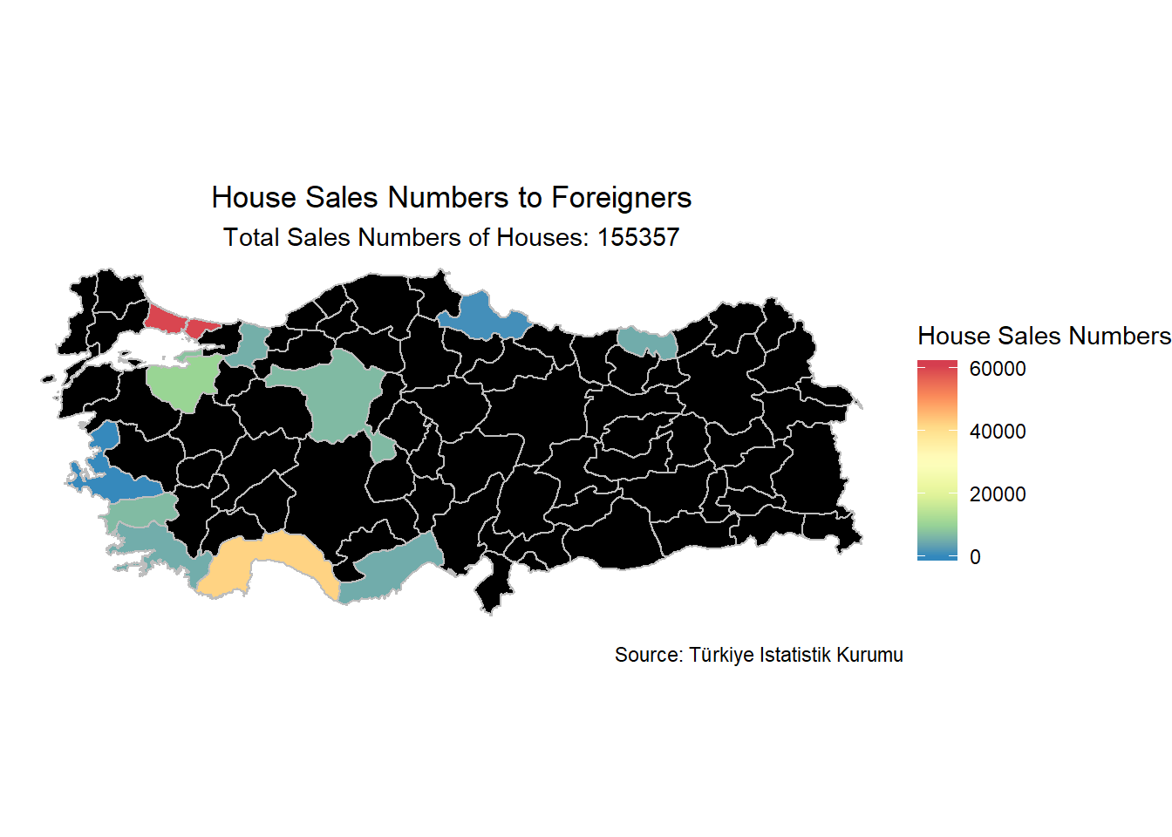
And we can see the distribution over Turkey map
1.Istanbul
2.Antalya
..
10.İzmir
11.Samsun
Istanbul has the highest sales density while Antalya follows.
Although Samsun and Izmir have the lowest sales density

Slide 8
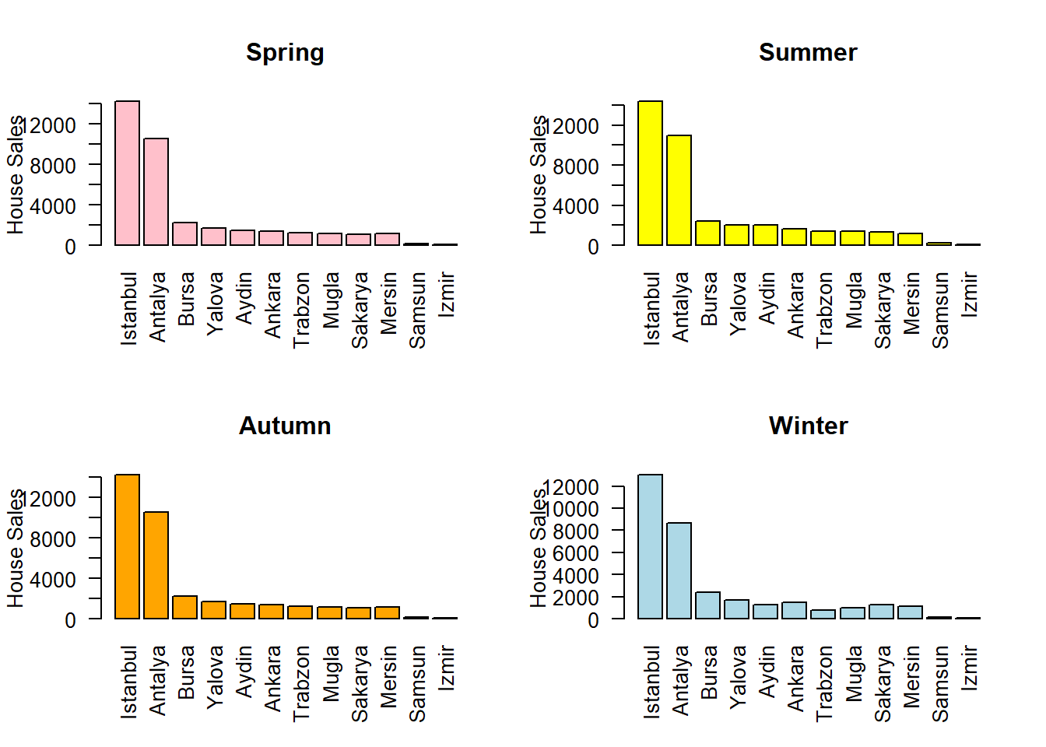
Does the sales amount change by season ?
This plot states that seasons doesn't have significant impact on house sales.

Slide 9
House Sales to men and women from 2014 to 2018
An interesting point here is, house sales to males from 2017 through 2018 is decreasing,
altough sales to female in same period is increasing.

Slide 10
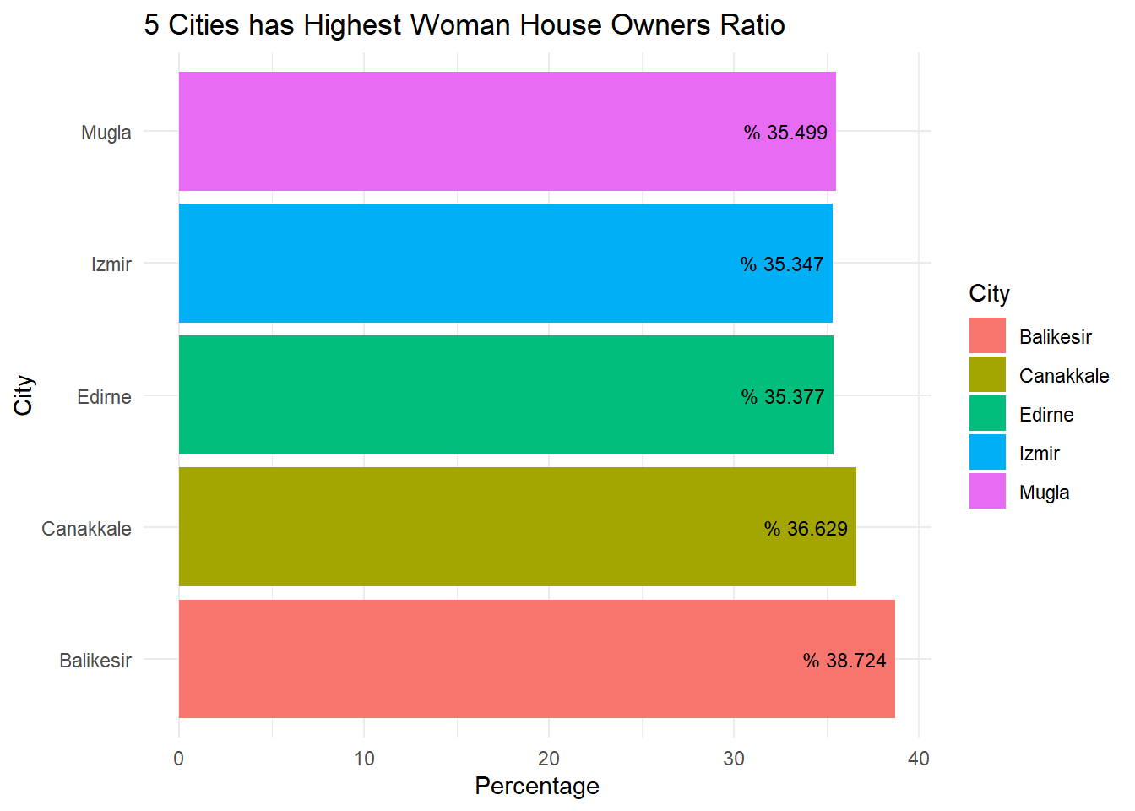
$ pink dollars
Balıkesir take the lead for female owners ratio among other cities while Canakkale follows.
Ege, Marmara and Akdeniz are the regions
has highest female house owner ratio.

Slide 11
Total Sales Numbers per country since 2015
The countries whose total sales is more than 5k
Iraq
25398
Saudi Arabia
12493
Iran
10012
Kuwait
9385
Russia
9119
Afghanistan6686
Germany
5643
United Kingdom
5026

Slide 12

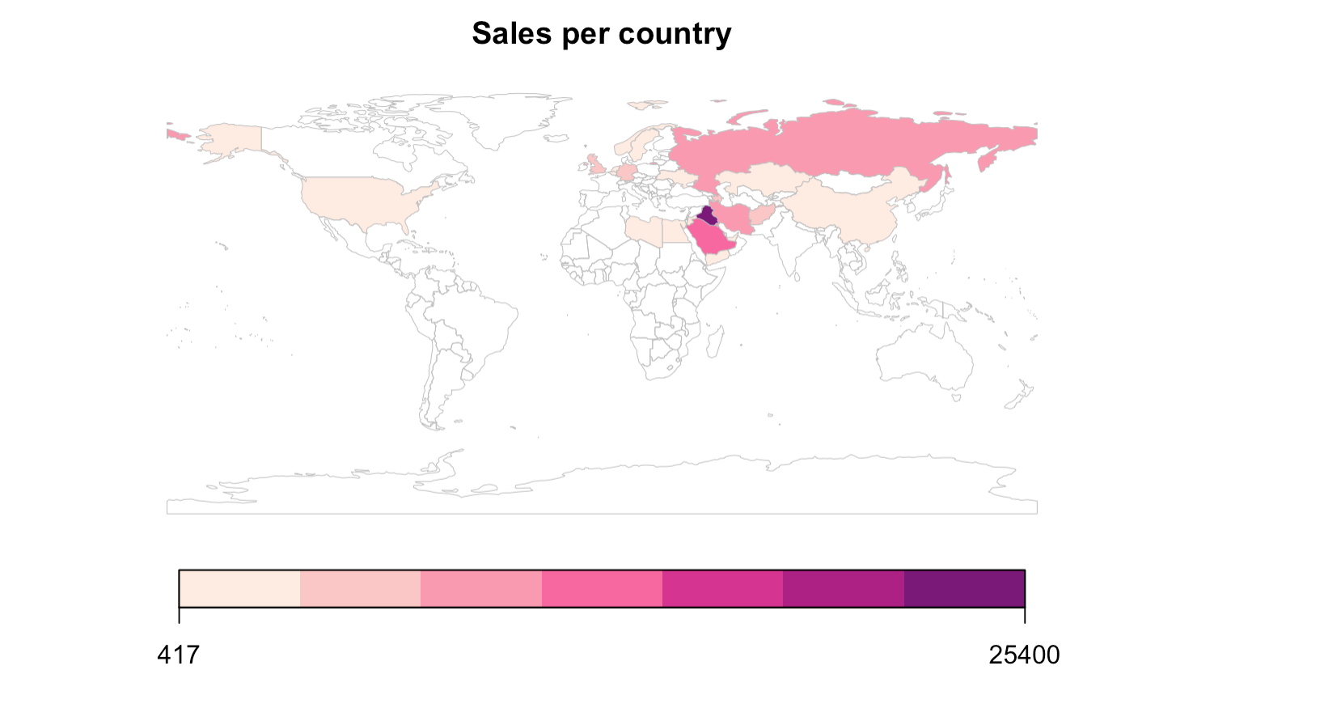

Slide 13


Thank you for listening
Emre Usta
Erkan Tekingül
Tuğçe Aydın
Bilgehan Kıran Çelebi
Gökhan Koca

